Slide 1

Car Resale Price Prediction Using Machine Learning
Team Project : Machine learning: Fundamentals and Applications (AAI-510)
Under the guidance of:
Prof. Raj Garg
University of San Diego
Submitted by:
Team 8
Nitin Mishra, Satyam Kumar, Rishabh
Notes:
Welcome everyone to our final team project presentation. Today, we’re showcasing a real-world solution titled Car Resale Price Prediction Using Machine Learning. This project combines data science and business intelligence to address pricing inconsistencies in India’s growing used car market. This initiative was developed as part of our Machine Learning course under the guidance of Professor Raj Garg at the University of San Diego.

Slide 2

Executive Summary
What We Did:
We built a machine learning-based pricing model to accurately predict resale values of used cars.
Combined insights from two datasets – a compact (301 rows) and a detailed (8128 rows) version.
Built and compared multiple ML models; XGBoost emerged as the best performer.
Why It Matters:
Pricing in the used-car market is often arbitrary, leading to loss of trust and inefficiencies.
Our model enables fair, data-backed pricing for platforms, dealers, and individual sellers.
Impact:
Final model achieved R² = 0.9453, MAE ≈ ₹49,000 – a highly accurate and deployable solution.
Notes:
Our goal was to create a predictive model to estimate the resale value of used cars accurately. We merged insights from two datasets: a smaller, cleaner one with 301 records and a more detailed set with over 8,000 records. After exploring and evaluating multiple regression models, XGBoost emerged as our top performer. Why does this matter? Because pricing in the used car market is often inconsistent, leading to lost trust and poor decisions. Our solution brings transparency to all stakeholders—buyers, sellers, and platforms—backed by an impressive R² score of 0.9453 and an MAE of ₹49 thoussadn

Slide 3

Problem Statement
Industry Context:
The Indian used-car market is projected to grow 15% annually, with digital resale platforms gaining popularity.
Buyers face inconsistent pricing, while sellers struggle to justify
Problem We Address:
How can we use machine learning to build a transparent, data-driven pricing tool?
Goal:
Predict the resale price of used cars using machine learning models for better pricing insights based on features like age, price, engine, power, mileage, brand, etc.
Support fair valuation, reduce negotiation friction, and improve buyer–seller confidence.
Notes:
The Indian used car market is expanding at a rate of 15% annually, powered by digital platforms. Despite this, pricing remains inconsistent. Sellers often can't justify the price they quote, while buyers lack reliable benchmarks. We framed the challenge as a data science problem: How can machine learning enable transparent, fair, and consistent pricing? Our objective was to predict resale prices using attributes like car age, fuel type, mileage, engine capacity, power, and more—ultimately supporting fair valuation and reducing negotiation friction

Slide 4

Solution Approach
1. Problem Understanding Clarified the use case: Predicting resale price from car specifications.
2. Data Collection Gathered two datasets to ensure diversity and scalability of the solution.
3. Data Exploration & Cleaning Performed missing value treatment, feature extraction, and outlier management.
4. Feature Engineering Created new variables, encoded categorical data, and applied normalization techniques.
5. Model Building Implemented and compared multiple regression models including linear, tree-based, and ensemble techniques.
6. Hyperparameter Tuning Used RandomizedSearchCV to fine-tune model parameters for XGBoost.
7. Evaluation Compared models using R², MAE, and RMSE. Visualized predictions and residuals.
8. Final Selection Chose XGBoost based on performance and business interpretability.
Notes:
We adopted an 8-step structured approach to solve this problem:
Clarified the core use case—predicting resale price from car specs.
Gathered two distinct datasets to balance scale with clarity.
Cleaned and explored the data—treated missing values, capped outliers, and extracted features.
Performed feature engineering—new variables like car age, one-hot encoding, and normalization.
Built and compared multiple regression models including Linear Regression, Decision Trees, Random Forest, and XGBoost.
Tuned hyperparameters using RandomizedSearchCV.
Evaluated each model using R², MAE, and RMSE alongside visual diagnostics.
Selected XGBoost as the final model due to its balance of accuracy and interpretability

Slide 5

Dataset Overview
 | CarDekho Dataset | Car Details v3 Dataset
Rows | 301 | 8128
Columns | 9 | 13
Features | Basic: Year, Fuel, etc. | Advanced: Engine, Power, etc.
Target | Selling_Price | Selling_Price
Preprocessing Needed | Low | High
Combined Power: CarDekho → Easier to model, good for baseline.
Car details v3 → Richer insights, real-world scale.
Used both datasets to ensure diversity + scale.
Notes:
We worked with two main datasets:
The CarDekho dataset: 301 records, 9 features, simple variables like year, fuel, and selling price.
Car Details v3: Over 8,000 records and 13 features, including power, torque, engine size—making it more suitable for real-world scale. We used both datasets to build models that were not just technically strong, but also scalable and practical in business settings.

Slide 6

Exploratory Data Analysis (EDA)
EDA helped us understand variable distributions, detect outliers, and identify relationships between features and the target variable.
Findings:
Most cars are petrol-based and manual transmission.
Cars sold by individuals tend to have lower prices than those sold by dealers.
Present_Price and Car_Age are the strongest predictors of resale value.
Higher Engine CC and Power ratings typically command higher resale prices.
Outliers in pricing and power were capped or removed to reduce distortion.
We used histograms, bar plots, boxplots, scatterplots, and correlation heatmaps to support our findings.
Notes:
Our EDA helped surface actionable patterns:
Most cars listed were petrol-based and had manual transmission.
Individual sellers typically quoted lower prices than dealerships.
Present price and car age were the most influential features on resale value.
Cars with higher engine capacity and power retained more value. We used histograms, boxplots, scatter plots, and heatmaps to derive these insights—while also capping or removing outliers to stabilize our models

Slide 7
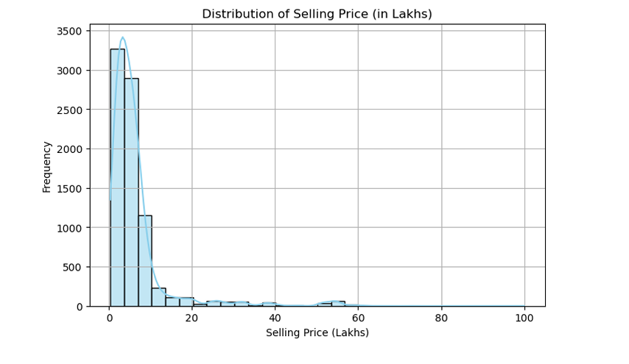
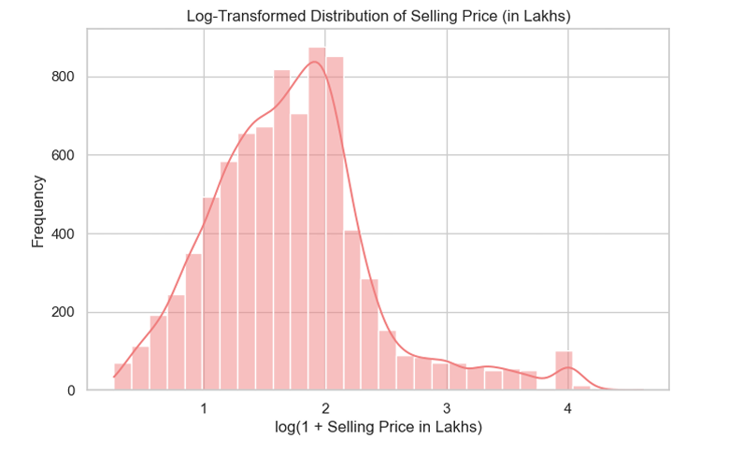
Distribution of Car Resale Prices
Notes:
Initial price data was highly skewed, making it difficult to model accurately. We applied log transformation to normalize the distribution.

Slide 8

Data Cleaning & Feature Engineering
Steps Taken:
Created Car_Age = 2020 - Year to replace Year
Converted Mileage, Engine, Power from text (e.g., "18.9 kmpl") to float
Handled missing values using median imputation (especially for power/mileage)
One-hot encoded categorical features (Fuel_Type, Transmission, Seller_Type)
Consolidated rare Owner categories for better model generalization
Applied log transformation to target (Selling_Price) to reduce skew and improve model fit
Outcome:
A clean, consistent, and machine-learning-ready dataset across both sources.
Notes:
We took several key steps to prepare the data:
Created a new 'Car Age' variable by subtracting the year from 2020.
Converted text-based fields like mileage and power into numeric formats.
Replaced missing values with median values to avoid skewing the results.
One-hot encoded categorical variables like Fuel Type and Seller Type.
Applied log transformation to the target variable (Selling Price). The result was a clean, structured dataset ready for machine learning

Slide 9
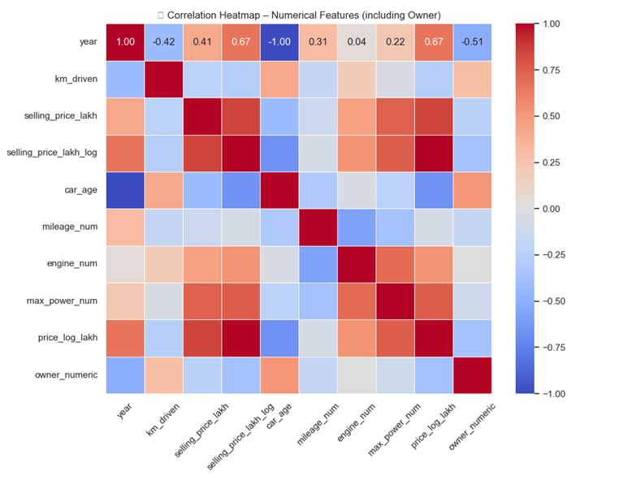
Correlation Heatmap of Numerical Features
Owner count shows a strong negative correlation (-0.51) with selling price.
Newer cars (higher year, lower age) have significantly higher resale value.
Powerful engines (max_power, engine size) moderately boost resale value.
Mileage and km driven show weak correlations, likely non-linear impact.
Adding owner info improves model understanding of resale variations.
Notes:
Our correlation heatmap revealed powerful insights:
Number of owners had a negative correlation with resale price (−0.51).
Newer cars—reflected by lower age—were priced higher.
Higher engine size and max power had moderate positive correlations with resale value.
Mileage and kilometers driven showed weak linear relationships, hinting at non-linear impacts. This analysis guided our feature selection and model refinement

Slide 10
Modeling Plan Overview
Objective: Build and evaluate machine learning models to predict the log-transformed resale price of used cars.
Step 1 – Train-Test Split:
Data split into 80% training and 20% testing sets using RFE-selected features, Ensures robust performance evaluation on unseen data.
Step 2 – Baseline Model:
Linear Regression to establish reference performance, Assumes a linear relationship with the log of selling price, Evaluated using RMSE, MAE, and R².
Step 3 – Advanced Models:
Explored Random Forest and XGBoost regressors, Captures non-linear patterns missed by linear models, Cross-validation and hyperparameter tuning via GridSearchCV improved accuracy.
Step 4 – Final Model Selection:
Compared models on accuracy, interpretability, and business relevance.
XGBoost selected for its best performance and balanced complexity.
Models are ready for deployment or integration into business systems

Slide 11
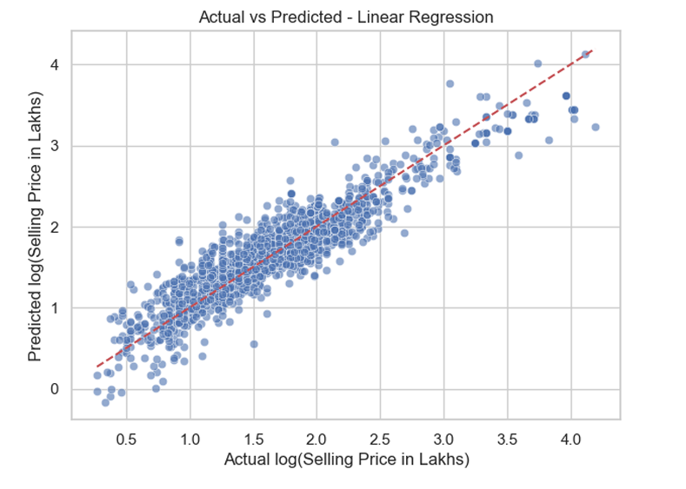
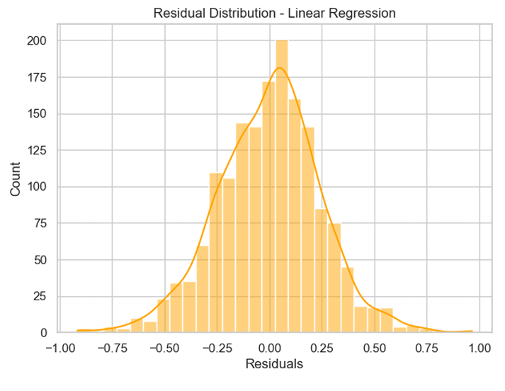
Linear Regression Model
Model: Linear Regression assumes a linear relationship between features and the log of the selling price.
Advantages: Easy to interpret and quick to train; serves as a strong baseline.
Limitations: Limited in capturing non-linear interactions and complex patterns in data.
Evaluation Results:
RMSE: 0.2444
MAE : 0.1904
R² : 0.8641
Inference: Performs well as a baseline model but is outperformed by advanced ensemble methods in this dataset.

Slide 12
Random Forest Model
Model: Random Forest Regressor uses multiple decision trees to improve predictive accuracy and control over-fitting.
Advantages: Captures complex non-linear relationships; reduces variance through ensemble averaging.
Limitations: Less interpretable than linear models; larger model size and computation.
Evaluation Results:
RMSE: 0.1587
MAE : 0.1112
R² : 0.9427
Inference: Strong improvement over linear regression; well-suited for capturing feature interactions and non-linear trends.

Slide 13
XGBoost Model
Model: XGBoost (Extreme Gradient Boosting) builds trees sequentially, focusing on correcting previous errors.
Advantages: High predictive power; handles complex relationships and missing data efficiently.
Limitations: Higher complexity; sensitive to hyperparameters.
Evaluation Results:
RMSE: 0.1549
MAE : 0.1084
R² : 0.9453
Inference: Best performing model on our dataset; recommended for deployment due to its accuracy and generalization ability.

Slide 14
Hyperparameter Tuning and Cross-Validation
Why Tuning?
Default model settings may not yield optimal performance. Hyperparameters like tree depth, learning rate, and estimators significantly impact model accuracy.
How We Tuned:
Applied GridSearchCV to both Random Forest and XGBoost., Used 5-fold cross-validation to evaluate performance across different hyperparameter combinations.
Best Parameters Found:
Random Forest: max_depth=20, n_estimators=200, min_samples_split=5
XGBoost: learning_rate=0.1, max_depth=7, n_estimators=200
Performance Boost:
Tuned models showed reduced RMSE and improved R² compared to untuned versions, Ensures better generalization and stability when predicting on unseen data.
Inference:
Hyperparameter tuning is essential for optimizing advanced models.
Cross-validation adds reliability and prevents overfitting, making our final models more trustworthy for business use.

Slide 15
Model Building & Comparison
We evaluated four different regression models using standard metrics:
Model | R² Score | MAE | RMSE
Linear Regression | 0.8641 | ₹1.03L | ₹1.86L
Random Forest | 0.9427 | ₹0.52L | ₹1.00L
XGBoost (Final) | 0.9453 | ₹0.49L | ₹0.98L
Inference:
XGBoost slightly outperforms Random Forest and significantly outperforms Linear Regression.
Both ensemble models capture complex patterns better than the linear model.
Ensemble models demonstrate high predictive power, validating our data cleaning, feature selection, and transformation efforts.

Slide 16

Final XG Boost Model Performance
Hyperparameter Tuning:
Used Randomized SearchCV with a range of depths, learning rates, and estimators & Performed cross-validation to ensure model generalizability.
Post-Processing:
Applied inverse log transformation to predicted prices.
Evaluation:
R² = 0.9453
MAE = ₹49,000
RMSE = ₹98,000
Residuals:
Nearly normal distribution
Homoscedastic variance
The final model showed strong predictive capability and minimal bias.

Slide 17

Business Value and Application
For Online Platforms:
Auto-suggest fair prices during listing
Enable dynamic pricing features
For Dealers:
Standardized pricing based on specifications
Inventory optimization through accurate valuation
For Buyers:
Price comparison across similar car models
Detect overpricing before purchase
This model increases trust, reduces negotiation friction, and enhances platform reputation.

Slide 18
Final Outcomes and Learnings
Conclusion:
Developed a high-accuracy ML model for car resale price prediction
Integrated preprocessing, transformation, modeling, and evaluation
XGBoost delivered best performance with interpretable outputs
Outcomes:
Demonstrated data-driven pricing is possible and practical
Model can transform user experience on online resale platforms
Business-ready solution with potential for further automation
Team Learnings:
Importance of clean data and thoughtful preprocessing
Role of hyperparameter tuning in maximizing performance
Business interpretation of machine learning outputs
Team collaboration and documentation across modules

Slide 19
Individual Contribution
Team Members | Satyam Kumar | Nitin Mishra | Rishabh
Dataset Selection | Yes | Yes | Yes
Github Setup |  | Yes | Yes
Domain Research | Yes | Yes | Yes
Exploratory Data Analysis | Yes | Yes | Yes
Data Preparation | Yes | Yes | Yes
Feature Engineering | Yes | Yes
Model Training | Yes | Yes | Yes
Model Evaluation | Yes |  | Yes
Technical Report | Yes | Yes | Yes
Presentation | Yes | Yes | Yes

Slide 20
References:
Agarwal, A., & Jain, A. (2020). Used Car Price Prediction using Machine Learning Techniques. International Journal of Scientific Research in Computer Science, Engineering and Information Technology, 6(1), 45–52.CarDekho. (2020).
Used Car Data Set. Retrieved from https://www.cardekho.com/Kaggle. (2020).
Car Details v3 Dataset. Retrieved from https://www.kaggle.com/nehalbirla/vehicle-dataset-from-cardekho
Chen, T., & Guestrin, C. (2016). XGBoost: A scalable tree boosting system. In Proceedings of the 22nd ACM SIGKDD International Conference on Knowledge Discovery and Data Mining (pp. 785–794). ACM. https://doi.org/10.1145/2939672.2939785
Pedregosa, F., Varoquaux, G., Gramfort, A., Michel, V., Thirion, B., Grisel, O., ... & Duchesnay, É. (2011). Scikit-learn: Machine Learning in Python. Journal of Machine Learning Research, 12, 2825–2830.

Slide 21
Thank You

